Slide 1
19th SEPT 2025
AN INTRODUCTION TO​
WEB DEVELOPMENT
HTML, CSS & JAVASCRIPT
SUBMITTED BY – KARTHIK.M
NM ID - 9421F001FC50200A3B34A39B813F20E0

Slide 2
PPT下载 http://www.1ppt.com/xiazai/
CONTENTS
INTRODUCTION
01
Introduction Of WEB DEVELOPMENT
HTML
02
About the HTML Language
CSS
03
All to know about CSS Language
JAVASCRIPT
04
The Scripting Language JAVASCRIPT

Slide 3
WEB DEVELOPMENT
Web development = building and maintaining websites
Notes:
Template from: https://www.freeppt7.com/

Slide 4

1. WEB DEVELOPMENT
What is Web Development?
Process of creating & maintaining websites.
Two Main Parts:
Frontend → User interface (HTML, CSS, JS).
Backend → Server, database, application logic.
Why Important?
HTML = Structure.
CSS = Style.
JavaScript = Interactivity.
Tech stacks of Web Development

Slide 5
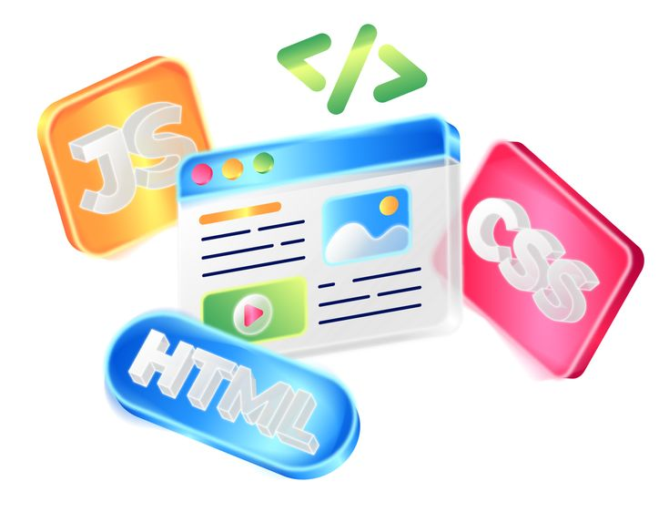

Front-End
The part of a website or app that users actually see and interact with.
Back-End
The part that handles logic, data, and communication with databases.

Slide 6
HTML
Hypertext Markup Language
Notes:
Template from: https://www.freeppt7.com/

Slide 7
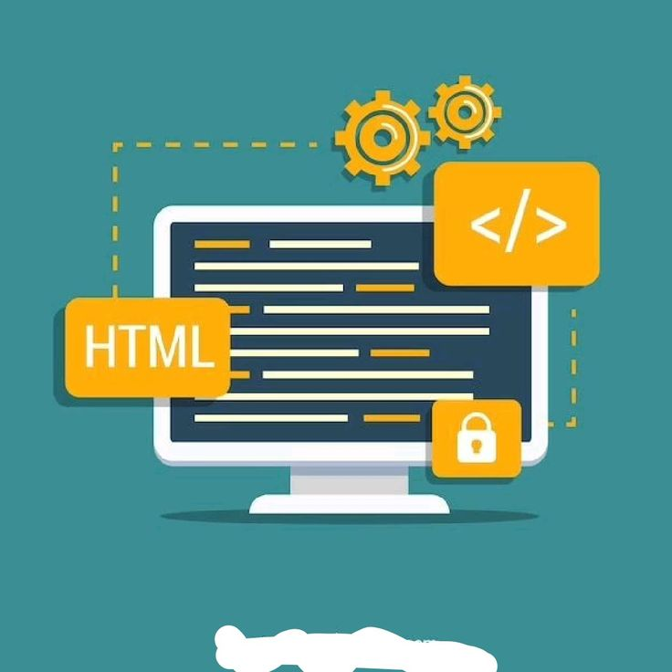
2. HTML : Introduction
What is HTML?
Stands for Hyper Text Markup Language.
Standard language for creating web pages.
Provides structure & content of a webpage.
Key Points :
Uses tags & elements.
Not a programming language → It’s a markup language.
Every website starts with HTML.

Slide 8
2 (i) . HTML : Common Tags
Headings (<h1> to <h6>)
Used to display titles or headings in different sizes. <h1> is the largest, <h6> is the smallest.
Paragraph (<p>)
Defines a block of text. Every paragraph is automatically separated with some spacing.
Link (<a>)
Creates clickable hyperlinks that connect one page to another or redirect to external websites.
Image (<img>)​
Allows insertion of images into a webpage to make content more visual and attractive.​
​
Table (<table>)​
Organizes information into rows and columns, useful for displaying structured data.​

Slide 9
Key Points:​
<!DOCTYPE html> → Defines document type​.
<html> → Root element​.
<head> → Metadata & title​.
<body> → Main content shown to users.
Browser Output:
Hello, World! This is my first webpage.
Basically, you’ll see:
A big heading that says Hello, World!.
A paragraph below: This is my first webpage.
2 (ii) . HTML : Basic Structure
General Layout of an HTML Page:
<!DOCTYPE html> <html> <head> <title>My First Page</title> </head> <body> <h1>Hello, World!</h1> <p>This is my first webpage.</p> </body> </html>

Slide 10
CSS
Cascading Style Sheets
Notes:
Template from: https://www.freeppt7.com/

Slide 11
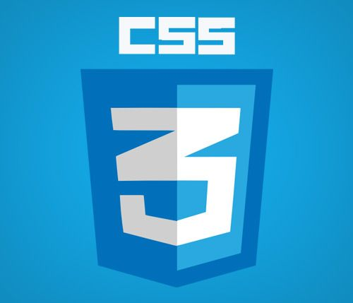
3. CSS : Introduction
1. What is CSS?
Stands for Cascading Style Sheets.
Used to style and design web pages.
Works with HTML to improve the visual experience.
2. Importance of CSS
Separates content (HTML) from design.
Controls layout, colors, fonts, and spacing.
Makes websites more attractive, responsive, and user-friendly.

Slide 12
3 (i) . Different Types of CSS for Styling
01
02
03
Inline CSS :
Internal CSS :
External CSS :
Written directly inside the HTML tag.
Affects only that specific element.
Used for quick styling but not recommended for large projects.
Defined inside the <style> tag within the HTML <head>.
Styles apply to the entire page.
Easier to manage than inline CSS.
Stored in a separate .css file.
Linked to HTML using <link> tag.
Best practice for large websites → reusable & efficient.

Slide 13
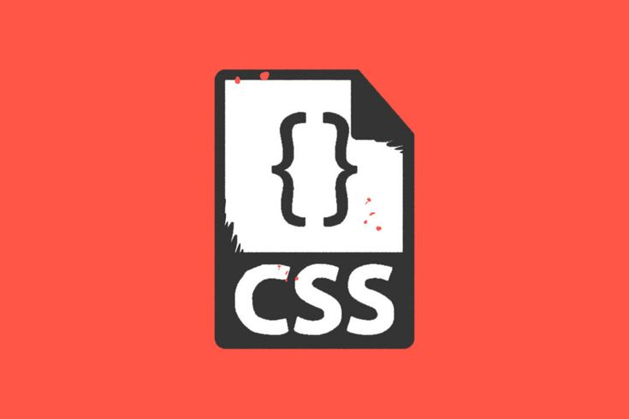
3 (ii) . CSS : Styling
3. Box & Layout Styling​
​
Control margins, padding, borders​.
Create layouts with flexbox or grid​.
Add shadows and rounded corners for design effects.
1. Text Styling
Change font size, color, and family
Apply bold, italic, underline effects.
2. Background Styling
Set background colors or images
Add gradients for modern design.

Slide 14
JAVASCRIPT
Making Websites Interactive and Dynamic
Notes:
Template from: https://www.freeppt7.com/

Slide 15

4 . JAVASCRIPT : Introduction
3. Where is JavaScript Used?
Frontend → Interactive websites, forms, menus.
Backend → Server-side programming with Node.js.
Applications → Web apps, mobile apps, even games.
1. What is JavaScript?
Programming language of the web.
Works with HTML & CSS to build complete websites.
Runs directly inside web browsers.
2. Why Use JavaScript?
Adds interactivity to web pages..
Responds to user actions like clicks, typing, and scrolling.
Supports animations, effects, and dynamic content updates.

Slide 16
4 (ii) . JavaScript : Features
Lightweight & Fast
Runs directly in the browser
No compilation required
Event-Driven
Reacts to user actions in real time
Handles clicks, typing, scrolling, and more
01
02
01
02
03
Cross-Platform & Versatile
Works on all major browsers and devices
Powers both frontend and backend (Node.js)
0

Slide 17
4 (iii) . JavaScript : Basic Code
Key Point:
JavaScript can change webpage content dynamically when a user interacts with it.
Browser's Output:
Displays heading “Hello”
A button labeled “Click Me”
On clicking → heading changes to “Hello JavaScript!”
From Clicks to Action :
<!DOCTYPE html> <html> <body> <h2 id="demo">Hello</h2> <button onclick="document.getElementById
('demo').innerHTML='Hello JavaScript!'"> Click Me </button> </body> </html>

Slide 18

4 (iv) . JAVASCRIPT - Uses
ONE
Interactive Websites
Create menus, sliders, tabs, and dynamic content.
Improves user engagement and usability.
​TWO
Form Validation
Check user input before submission.
Ensures correct data entry and reduces errors.
1
THREE
Web & Mobile Applications
Build web apps (e.g., Gmail, Google Docs).
Used in mobile apps via frameworks like React Native.
to add content, content to matc the title.

Slide 19
Comparison of HTML, CSS & JavaScript
Understanding Their Roles in Web Development
HTML – Structure
Provides the skeleton of a webpage.
Defines headings, paragraphs, links, images, and tables.
CSS – Styling
Controls appearance and layout.
Handles colors, fonts, spacing, and responsive design.
JavaScript – Interactivity
Adds dynamic behavior.
Handles user actions, animations, and real-time updates.
Click here to add content, content to match the title.
01
02
03

Slide 20
Real-time Applications / Importance
Where Web Development Meets the Real World
E-commerce sites, blogs, news portals
Provide information and services online
WEBSITES
1
WEB APPLICATIONS
Gmail, Google Docs, online banking apps
Enable interactive, dynamic user experiences
2
Built using web technologies (JavaScript frameworks like React Native)
MOBILE & HYBRID APPS
3
Boosts business visibility, accessibility, and customer satisfaction
USER ENGAGEMENT
4

Slide 21

Conclusion & References
1. Key Takeaways
HTML → Provides the structure of web pages..
CSS → Adds styling and visual appeal
JavaScript → Enables interactivity and dynamic behavior.
2. Importance
Together, they form the foundation of all modern websites and web apps.
Essential for building responsive, attractive, and functional digital experiences.
3. References
W3Schools – https://www.w3schools.com
MDN Web Docs – https://developer.mozilla.org
TutorialsPoint – https://www.tutorialspoint.com

Slide 22
THANK YOU !

